Slide 1
Structuring System Requirements:
Process Modeling

Slide 2
Learning Objectives
Understand the logical modeling of processes through studying data flow diagrams
How to draw data flow diagrams using rules and guidelines
How to decompose data flow diagrams into lower-level diagrams
Balancing of data flow diagrams
8.2

Slide 3
Learning Objectives
Explain the differences among four types of DFDs: current physical, current logical, new physical and new logical
Discuss the use of data flow diagrams as analysis tools
Compare and contrast data flow diagrams with Oracle’s process modeling tool and with functional hierarchy diagrams
Discuss process modeling for Internet applications
8.<number>

Slide 4
Process Modeling
Graphically represent the processes that capture, manipulate, store and distribute data between a system and its environment and among system components
Data flow diagrams (DFD)
  Graphically illustrate movement of data between external entities and the processes and data stores within a system
8.<number>

Slide 5
Process Modeling
Modeling a system’s process
  Utilize information gathered during requirements determination
  Structure of the data is also modeled in addition to the processes
Deliverables and Outcomes
  Set of coherent, interrelated data flow diagrams
8.<number>

Slide 6
Process Modeling
Deliverables and outcomes (continued)
  Context data flow diagram (DFD)
    Scope of system
  DFDs of current system
    Enables analysts to understand current system
  DFDs of new logical system
    Technology independent
    Show data flows, structure and functional requirements of new system
8.<number>

Slide 7
Process Modeling
Deliverables and outcomes (continued)
  Project dictionary and CASE repository
8.<number>

Slide 8
Data Flow Diagramming Mechanics
Four symbols are used
  Two different standard sets can be used
    DeMarco and Yourdan
    Gane and Sarson
8.<number>

Slide 9
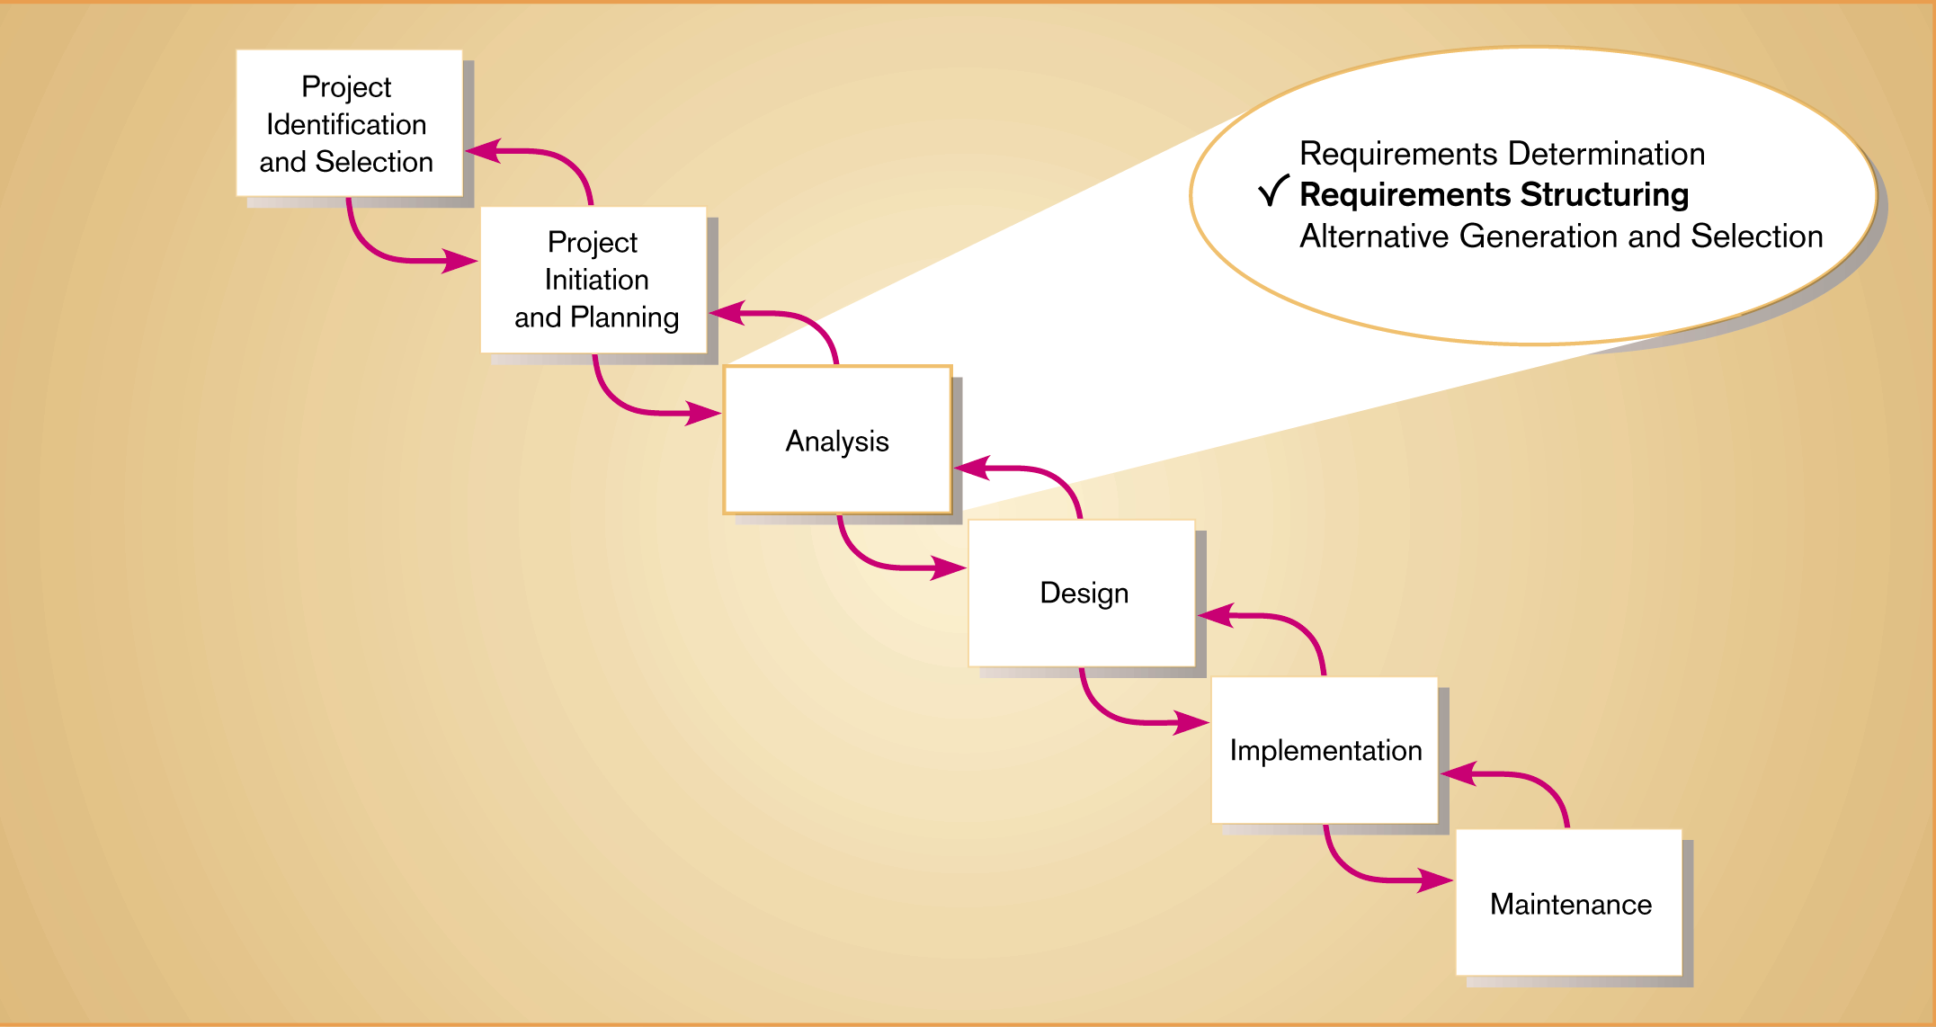
Figure 8-2
Comparison of DeMarco & Yourdan and Gane & Sarson DFD symbol sets
8.<number>

Slide 10
Data Flow Diagramming Mechanics
Data Flow
  Depicts data that are in motion and moving as a unit from one place to another in the system.
  Drawn as an arrow
  Select a meaningful name to represent the data
8.<number>

Slide 11
Data Flow Diagramming Mechanics
Data Store
  Depicts data at rest
  May represent data in
    File folder
    Computer-based file
    Notebook
  The name of the store as well as the number are recorded in between lines
8.<number>

Slide 12
Data Flow Diagramming Mechanics
Process
  Depicts work or action performed on data so that they are transformed, stored or distributed
  Number of process as well as name are recorded
8.<number>

Slide 13
Data Flow Diagramming Mechanics
Source/Sink
  Depicts the origin and/or destination of the data
  Sometimes referred to as an external entity
  Drawn as a square symbol
  Name states what the external agent is
  Because they are external, many characteristics are not of interest to us
8.<number>

Slide 14
Data Flow Diagramming Definitions
Context Diagram
  A data flow diagram (DFD) of the scope of an organizational system that shows the system boundaries, external entities that interact with the system and the major information flows between the entities and the system
Level-O Diagram
  A data flow diagram (DFD) that represents a system’s major processes, data flows and data stores at a high level of detail
8.<number>

Slide 15
Developing DFDs: An Example
Hoosier Burger’s automated food ordering system
Context Diagram (Figure 8-4) contains no data stores
Next step is to expand the context diagram to show the breakdown of processes (Figure 8-5)
8.<number>

Slide 16
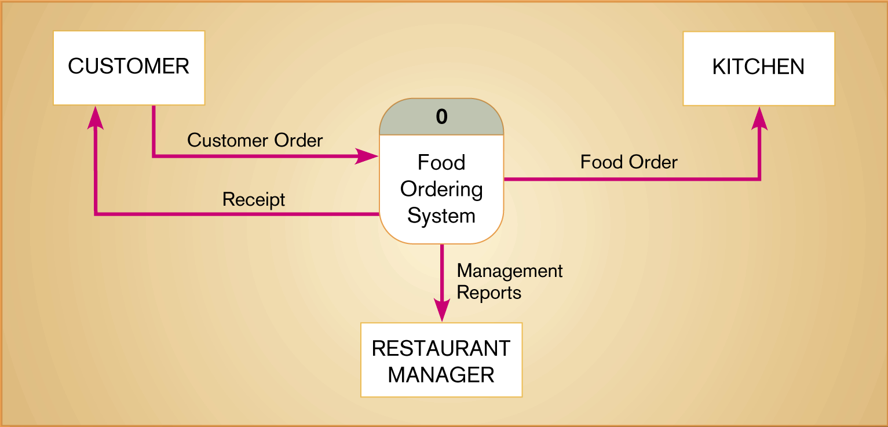
Figure 8-4
Context diagram of Hoosier Burger’s food ordering system
8.<number>

Slide 17
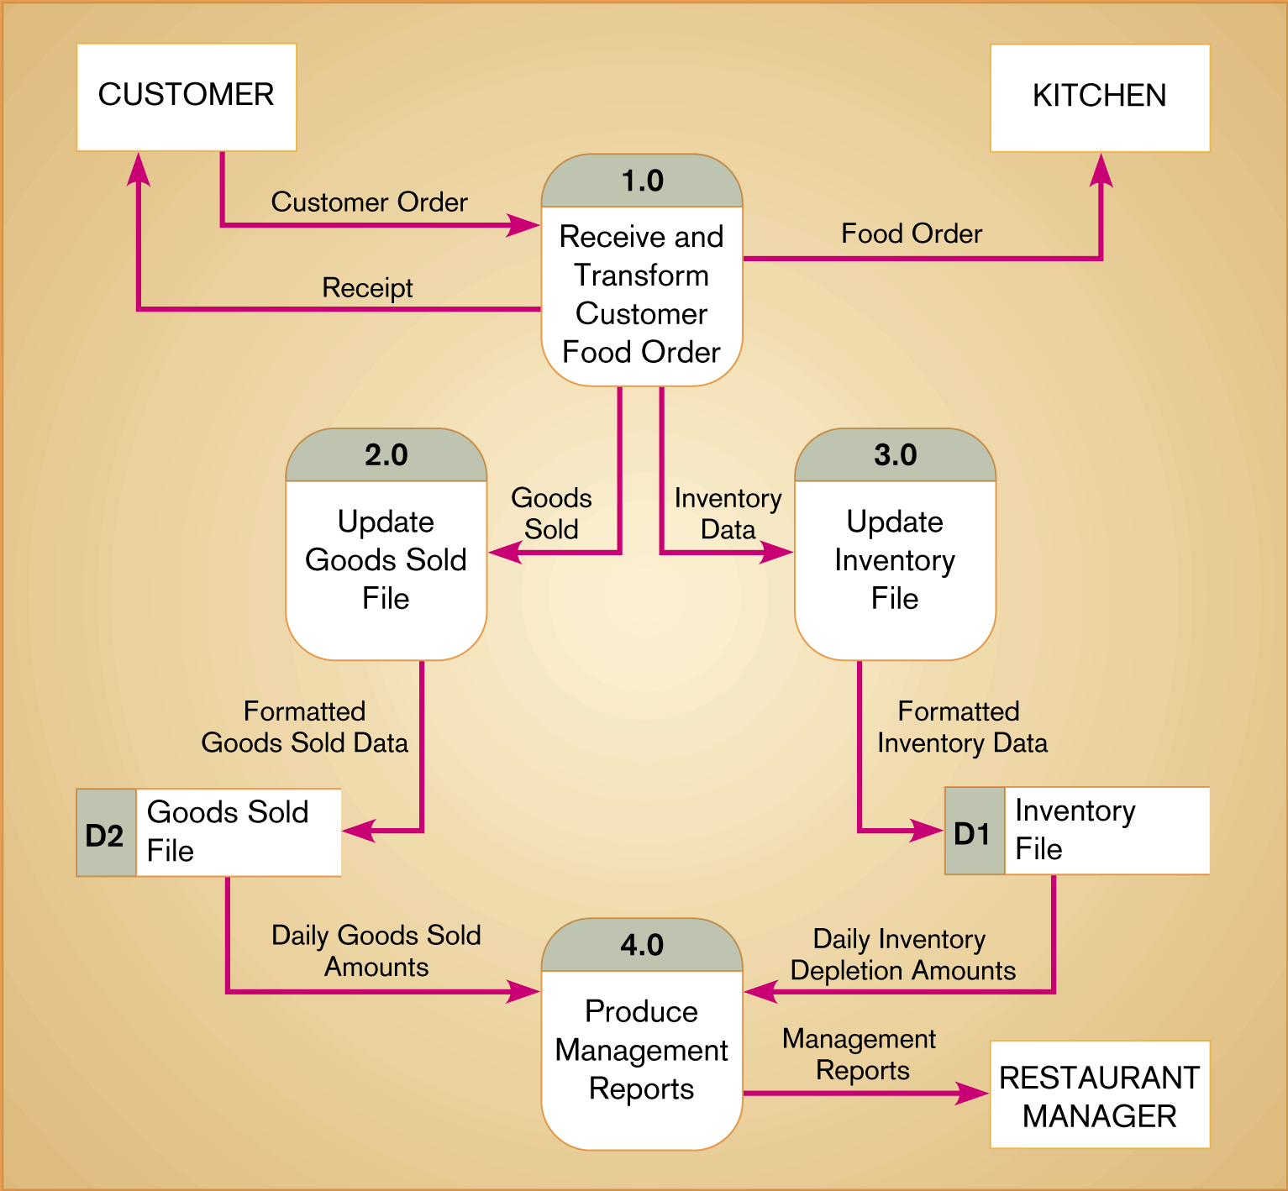
Figure 8-5
Level-0 DFD of Hoosier Burger’s food ordering system
8.<number>

Slide 18
Data Flow Diagramming Rules
Basic rules that apply to all DFDs
  Inputs to a process are always different than outputs
  Objects always have a unique name
    In order to keep the diagram uncluttered, you can repeat data stores and sources/sinks on a diagram
8.<number>

Slide 19
Data Flow Diagramming Rules
Process
  No process can have only outputs (a miracle)
  No process can have only inputs (black hole)
  A process has a verb phrase label
Data Store
  Data cannot be moved directly from one store to another
  Data cannot move directly from an outside source to a data store
  Data cannot move directly from a data store to a data sink
  Data store has a noun phrase label
8.<number>

Slide 20
Data Flow Diagramming Rules
Source/Sink
  Data cannot move directly from a source to a sink
  A source/sink has a noun phrase label
Data Flow
  A data flow has only one direction of flow between symbols
  A fork means that exactly the same data goes from a common location to two or more processes, data stores or sources/sinks
8.<number>

Slide 21
Data Flow Diagramming Rules
Data Flow (Continued)
  A join means that exactly the same data comes from any two or more different processes, data stores or sources/sinks to a common location
  A data flow cannot go directly back to the same process it leaves
  A data flow to a data store means update
  A data flow from a data store means retrieve or use
  A data flow has a noun phrase label
8.<number>

Slide 22
Decomposition of DFDs
Functional decomposition
  Act of going from one single system to many component processes
  Repetitive procedure
  Lowest level is called a primitive DFD
Level-N Diagrams
  A DFD that is the result of n nested decompositions of a series of subprocesses from a process on a level-0 diagram
8.<number>

Slide 23
Balancing DFDs
When decomposing a DFD, you must conserve inputs to and outputs from a process at the next level of decomposition
This is called balancing
Example: Hoosier Burgers
  In Figure 8-4, notice that there is one input to the system, the customer order
  Three outputs:
    Customer receipt
    Food order
    Management reports
8.<number>

Slide 24
Balancing DFDs
Example (Continued)
  Notice Figure 8-5. We have the same inputs and outputs
  No new inputs or outputs have been introduced
  We can say that the context diagram and level-0 DFD are balanced
8.<number>

Slide 25
Balancing DFDs
An unbalanced example
  Figure 8-10
  In context diagram, we have one input to the system, A and one output, B
  Level-0 diagram has one additional data flow, C
  These DFDs are not balanced
8.<number>

Slide 26

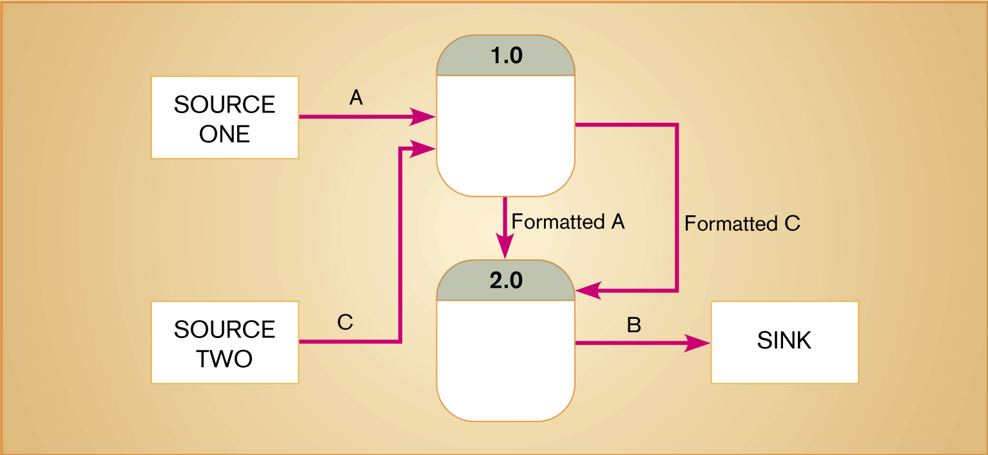
Figure 8-10
An unbalanced set of data flow diagrams
(a) Context diagram
(b) Level-0 diagram
8.<number>

Slide 27
Balancing DFDs
We can split a data flow into separate data flows on a lower level diagram (see Figure 8-11)
Balancing leads to four additional advanced rules (See Table 8-3)
8.<number>

Slide 28
Four Different Types of DFDS
Current Physical
  Process label includes an identification of the technology (people or systems) used to process the data
  Data flows and data stores are labeled with the actual name of the physical media on which data flow or in which data are stored
8.<number>

Slide 29
Four Different Types of DFDS
Current Logical
  Physical aspects of system are removed as much as possible
  Current system is reduced to data and processes that transform them
New Logical
  Includes additional functions
  Obsolete functions are removed
  Inefficient data flows are reorganized
8.<number>

Slide 30
Four Different Types of DFDS
New Physical
  Represents the physical implementation of the new system
8.<number>

Slide 31
Guidelines for Drawing DFDs
Completeness
  DFD must include all components necessary for system
  Each component must be fully described in the project dictionary or CASE repository
Consistency
  The extent to which information contained on one level of a set of nested DFDs is also included on other levels
8.<number>

Slide 32
Guidelines for Drawing DFDs
Timing
  Time is not represented well on DFDs
  Best to draw DFDs as if the system has never started and will never stop.
Iterative Development
  Analyst should expect to redraw diagram several times before reaching the closest approximation to the system being modeled
8.<number>

Slide 33
Guidelines for Drawing DFDs
Primitive DFDs
  Lowest logical level of decomposition
  Decision has to be made when to stop decomposition
8.<number>

Slide 34
Guidelines for Drawing DFDs
Rules for stopping decomposition
  When each process has been reduced to a single decision, calculation or database operation
  When each data store represents data about a single entity
  When the system user does not care to see any more detail
8.<number>

Slide 35
Guidelines for Drawing DFDs
Rules for stopping decomposition (continued)
  When every data flow does not need to be split further to show that data are handled in various ways
  When you believe that you have shown each business form or transaction, on-line display and report as a single data flow
  When you believe that there is a separate process for each choice on all lowest-level menu options
8.<number>

Slide 36
Using DFDs as Analysis Tools
Gap Analysis
  The process of discovering discrepancies between two or more sets of data flow diagrams or discrepancies within a single DFD
Inefficiencies in a system can often be identified through DFDs
8.<number>

Slide 37
Using DFDs in Business Process Reengineering
Example: IBM Credit
  See Figure 8-20 – before reengineering
  Credit approval process required six days before BPR
  Figure 8-21 depicts DFD after reengineering
  IBM was able to process 100 times the number of transactions in the same amount of time
8.<number>

Slide 38
Oracle’s Process Modeler and Functional Hierarchy Diagrams
Process Modeler
  Unique to Oracle
  Similar to DFDS but outputs and methods differ in several ways.
  Table 8-4 illustrates differences
Functional Hierarchy Diagrams
  Picture of various tasks performed in a business and how they are related
  Tasks are broken down into their various parts
  Does not include data flows
8.<number>

Slide 39
Summary
Data flow diagrams (DFD)
  Symbols
  Rules for creating
  Decomposition
  Balancing
Four different kinds of DFDs
  Current Physical
  Current Logical
  New Logical
  New Physical
8.<number>

Slide 40
Summary
DFDs for Analysis
DFDs for Business Process Reengineering (BPR)
Oracle’s Process Modeler
Functional Hierarchy Diagrams
8.<number>

